Slide 1
Black Panther
...a warrior
Game by ‘Code Warriors’

Slide 2
Design Patterns Highlights
Command
Observer
Factory Method
State

Slide 3
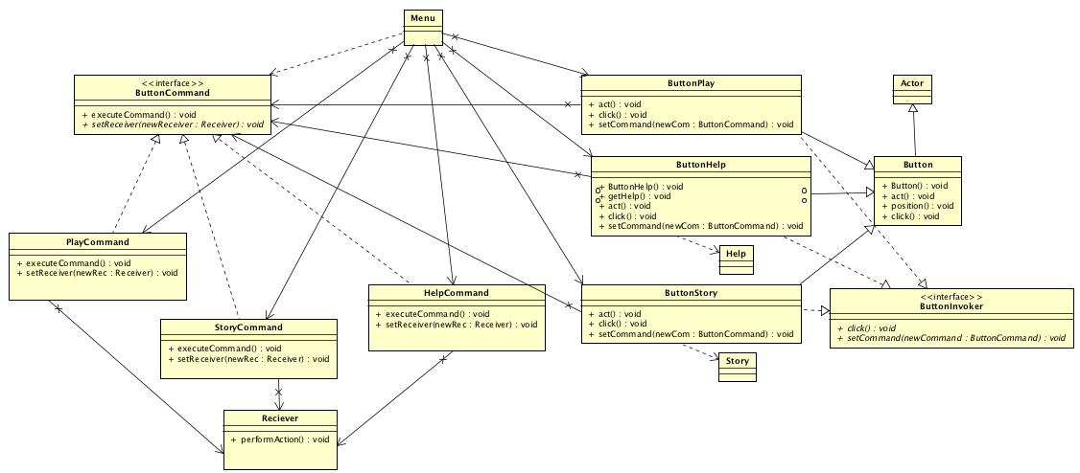
Command Pattern

Slide 4
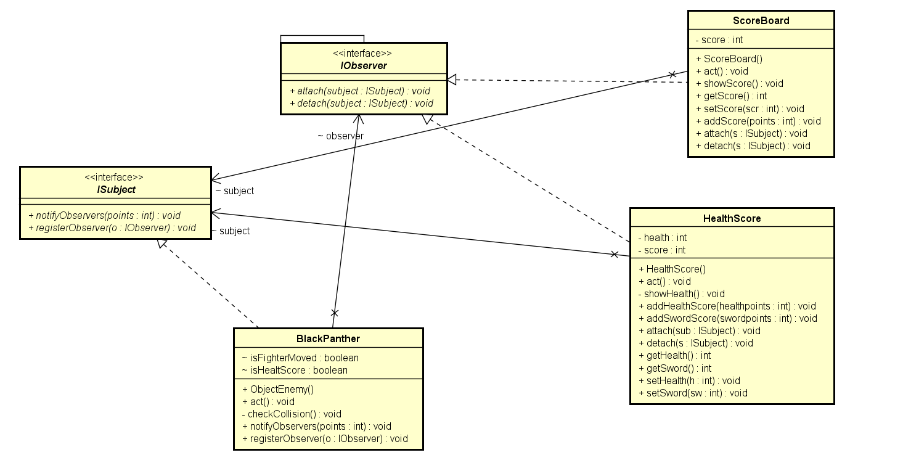
Observer Pattern

Slide 5
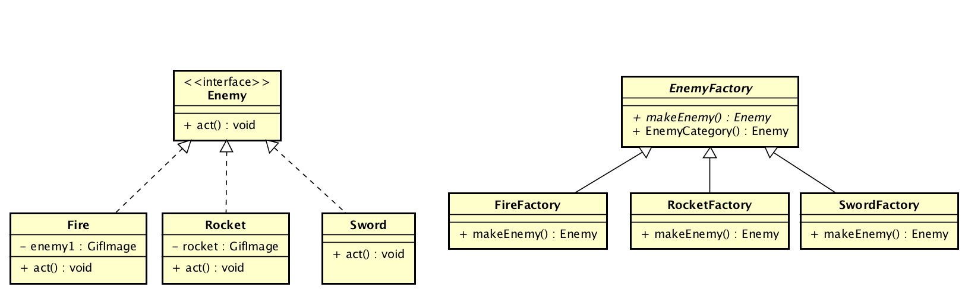
Factory pattern

Slide 6
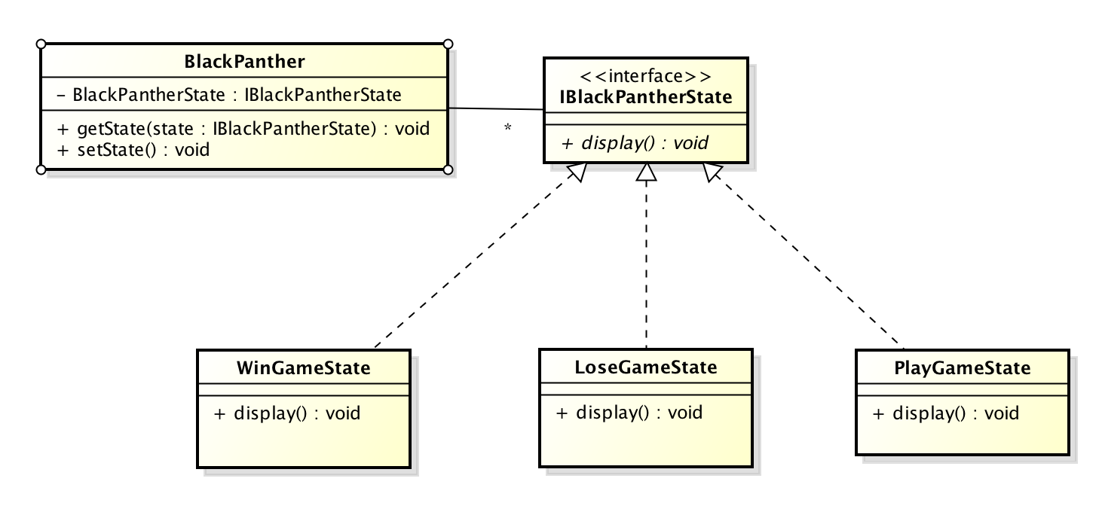
State Pattern

Slide 7
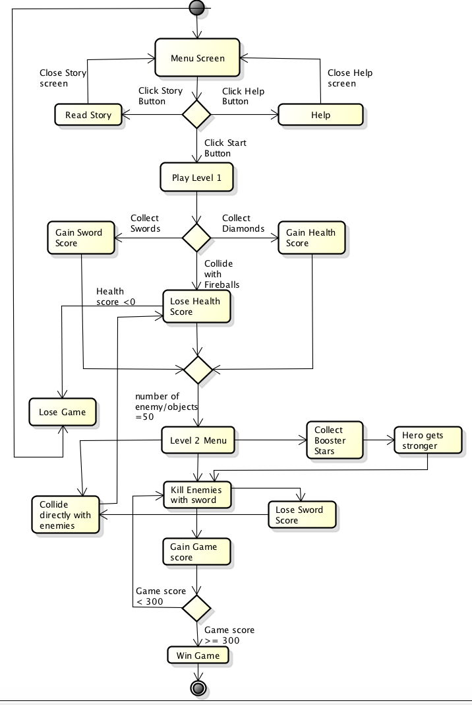
Activity Diagram

Slide 8
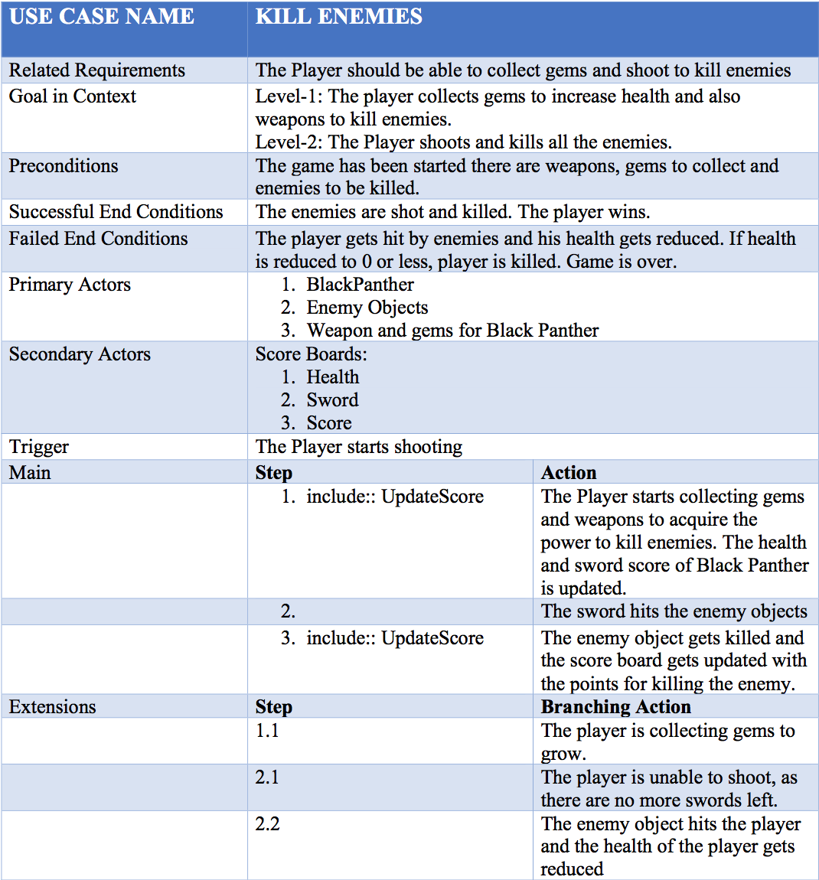
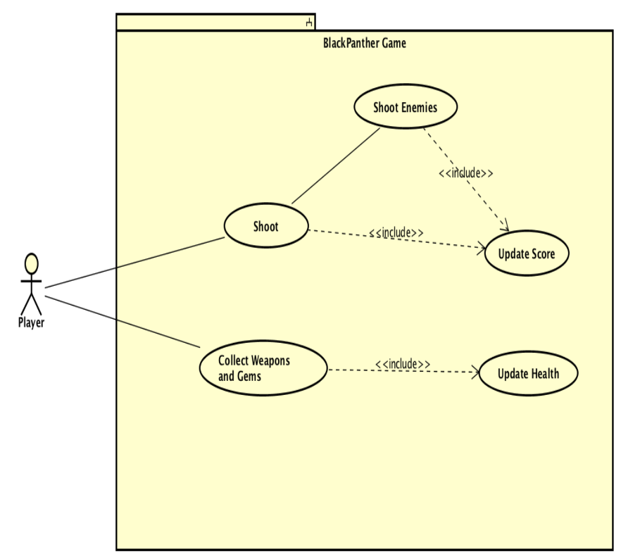
Use case Specification

Slide 9
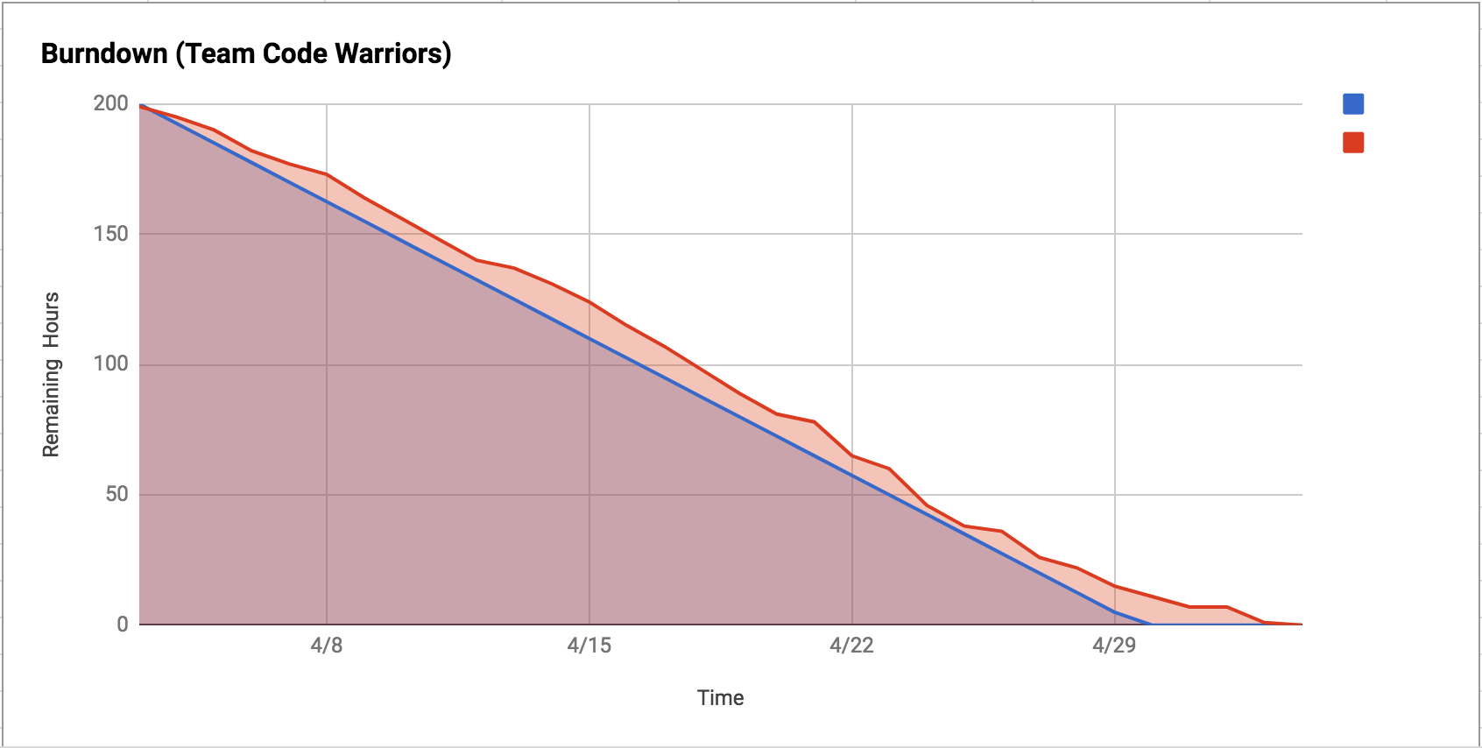
Burndown Chart

Slide 10
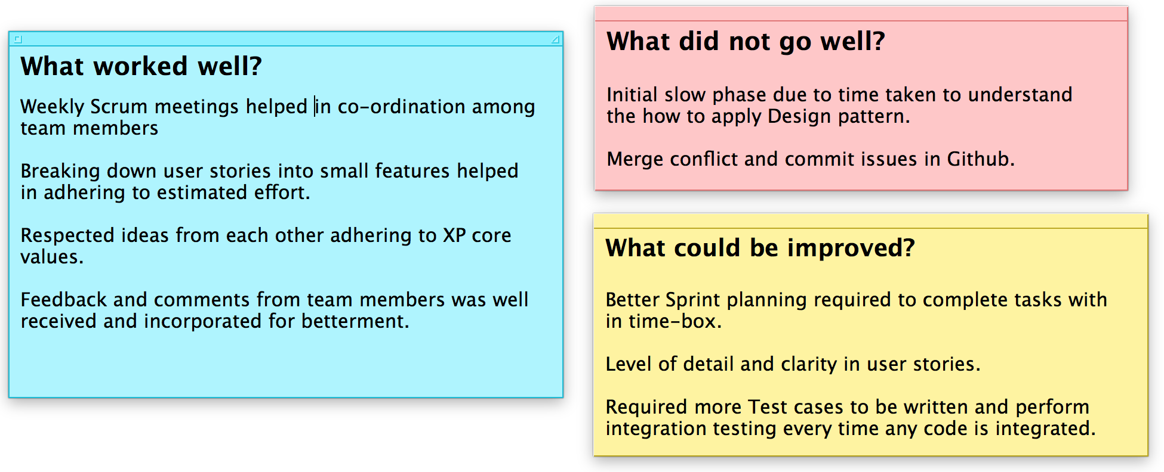
Sprint Retrospective

Slide 11

Thank you

